Slide 1
Summary of Ch.7. Sizing the Selling Organization
from
“Sales Force Design for Strategic Advantage”
by Andris A. Zoltners, Prabhakant Sinha and Sally E. Lorimer

Slide 2
Introduction
Sales force Size is defined as the number of salespeople. It’s changed depending on products and market conditions.
Following are common scenarios involving sizing:-
Generally, companies usually maintain their sales force size same as previous years.
Some only increase sales force size after accruing sales post-release (‘pay as you go’ approach).
Others downsize the sales force size to ‘enhance productivity’ by shifting costs.
Managing the sizing during a new product launch is challenging as salespeople need to focus on new product without losing the old products’ sales.
Usually, sales force size is cost contained i.e., it is determined on constant percent of yearly sales.
The effectiveness of the sale force size depends on the economic conditions, product’s target and geographies considered.

Slide 3
What is Sales force Sizing
The decision of sizing is based on many factors:
Starting with the number of salespeople: generalists, specialists, sales managers, telemarketing people, support people
Cost spent on the sales force: percentage of sales attributed to sales force
Variation between sales force size and profit
The sales force sizing depends on the company’s go-to-market strategy whether it is direct or and there are channels (distributers, resellers, partners, telesales, etc.) available.
Sales force sizing is affected by structure i.e., if it comprises/requires generalists or multi-specialty sales personnel
Territory alignment is another crucial aspect that is optimized with number of salespeople.

Slide 4
Sales force Sizing & Profitability
It is directly related as sales force is responsible for product/customer coverage. The number of salespeople is strongly linked to sales profit.
Sales force effort is linked to customer satisfaction and retention. The management can focus the number of salespeople for bigger accounts while giving the smaller ones to telesales to increase profit.
Sales force creates sales, a study determined that increasing sales force increases profit albeit with diminishing returns (Fig.7-2 next slide). This sales-effort relationship is essential for maximizing profit.
Carryover is observed in most industries: the impact of current sales force effort is not often immediate and observed after some period (Fig.7-3 next slide). Sales force sizing thus can have short/long-term impact on the firm.
Sales force is significant investment (costs) for customer connection. Other channels like telesales, internet, direct-mail and mass advertising cost less per contact than Sales force.

Slide 5
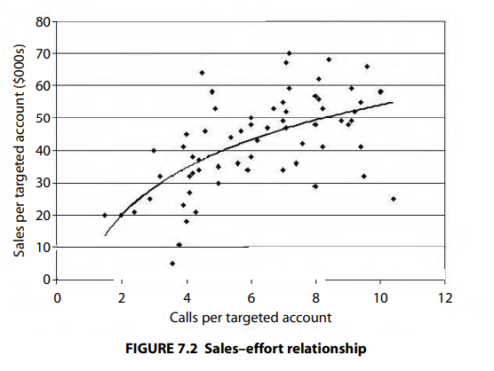
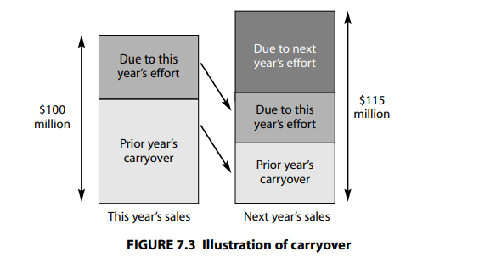
Sales force Sizing & Profitability (contd.)

Slide 6
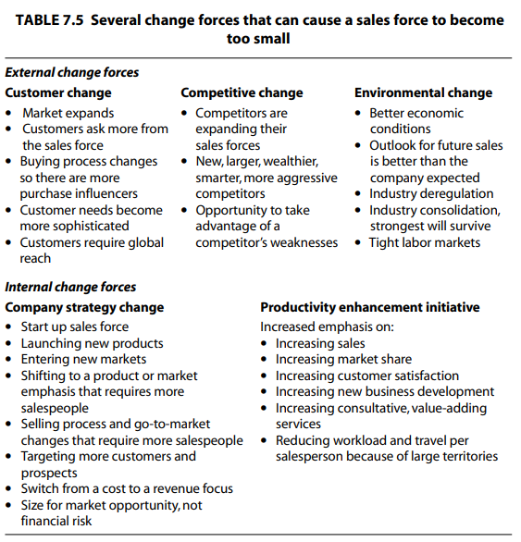
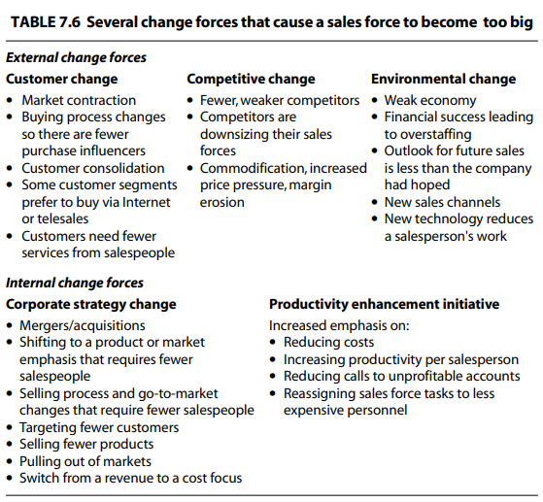
Is the Sales force the right size? Small or Big

Slide 7
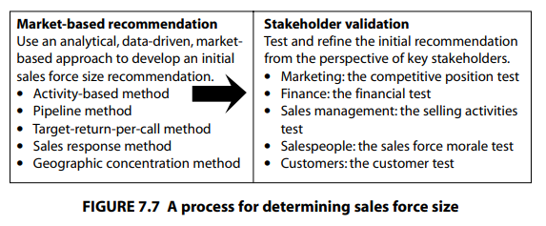
Determining the Sales force Size
(Traditional) Sales force sizing rationale:-
Keeping the sales force size the same as last year in order to avoid disruption and additional costs.
Maintaining a sales force size that keeps costs at a constant percentage of sales in order to contain sales force costs.
Increasing sales force size only after the company has generated the sales to pay for the size increase in order to avoid risk.
Matching the sales force sizing changes of major competitors in order to maintain share of voice.
The above rules and approaches hold merit in certain situations.
(Intuitive) Sales force sizing:-
This approach (Fig.7-7) incorporates market dynamics and the needs of various stakeholders in the sizing decision

Slide 8
(1/2) Market-based Recommendation
Activity-based approach
Pipeline method
Target-return-per-call method
Sales response method (used by IQVIA)
Geographic concentration method

Slide 9
(2/2) Stakeholder Validation
The market-based approaches provide an estimate for the right sales force size. Once this estimate has been developed, a series of sales force sizing tests can be used to validate the recommendation from the perspective of key stakeholders.

